Slide 1
Hands On Machine Learning
Chapter 07. Ensemble Learning and Random Forests
Sumin kang
ssmin0116@inha.edu
2024.10.31

Slide 2
INDEX
7.1 Voting Classifiers
7.2 Bagging and Pasting
7.3 Random Patches and Random Subspaces
7.4 Random Forests
7.5 Boosting
7.6 Stacking

Slide 3
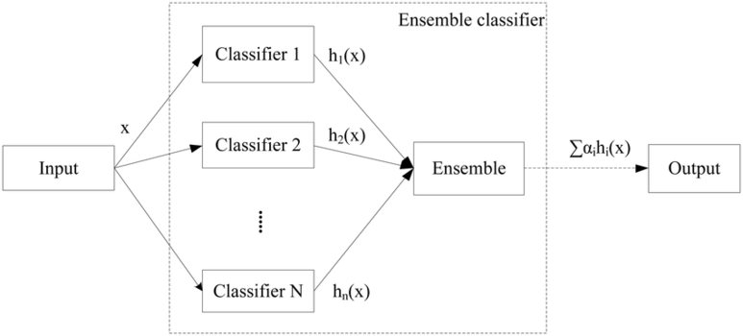
Ensemble Learning

Slide 4
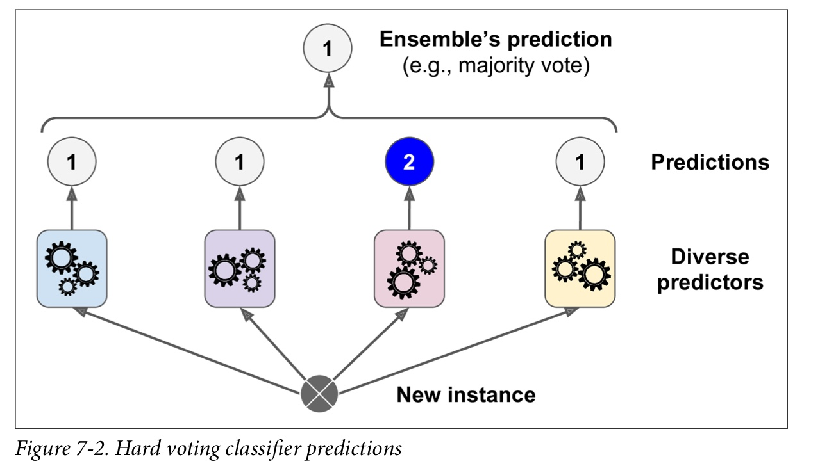
7.1 Voting Classifiers
<Hard voting classifier>
: Majority-vote classifier
The accuracy is often higher than the best classifier in the ensemble
Weak learner can be a strong learner

Slide 5
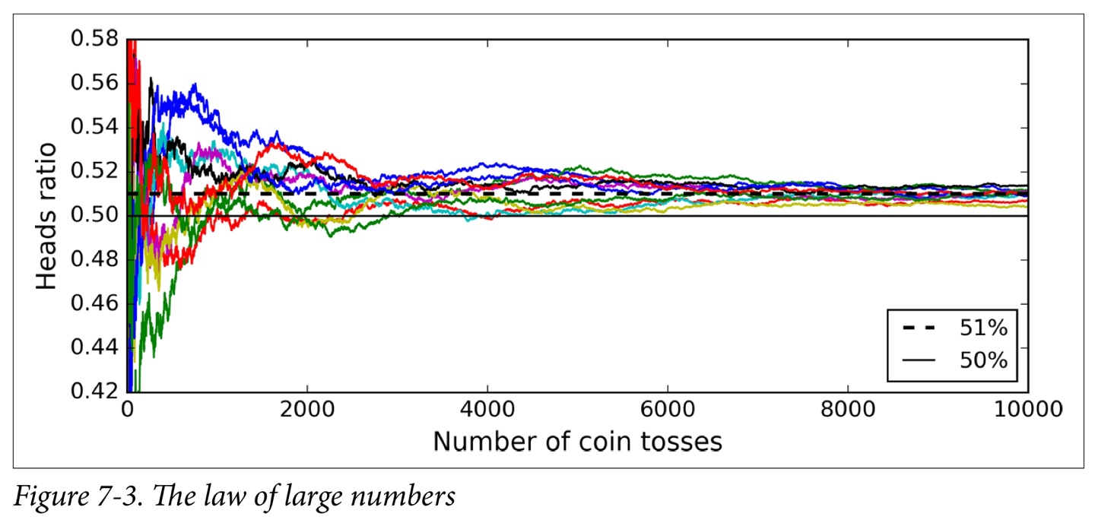
7.1 Voting Classifiers
Law of large numbers
: The result converges to the actual value as the number of trials increases

Slide 6
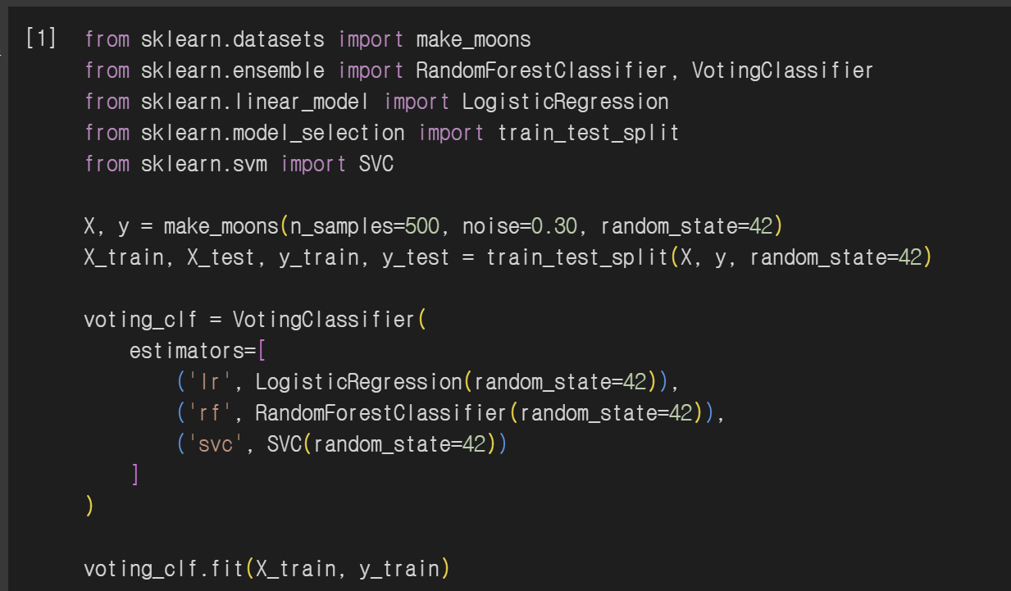
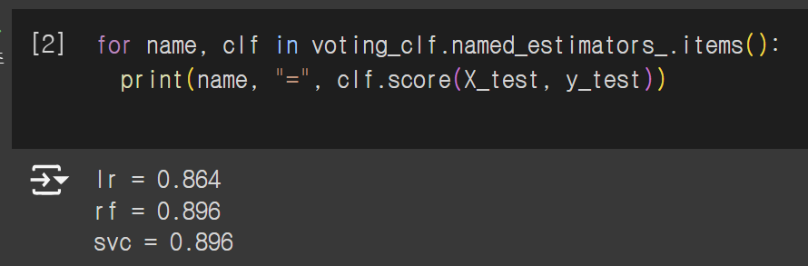
7.1 Voting Classifiers

Slide 7
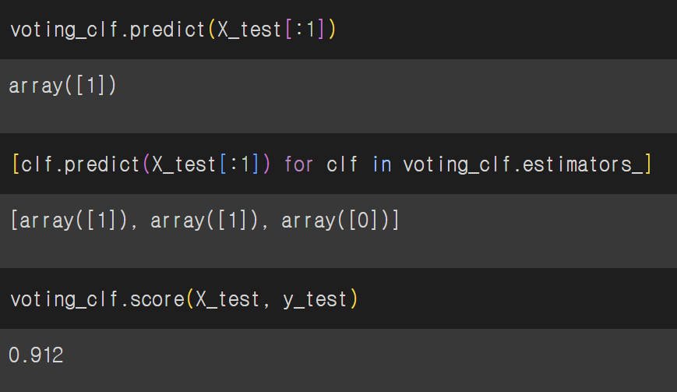
7.1 Voting Classifiers

Slide 8
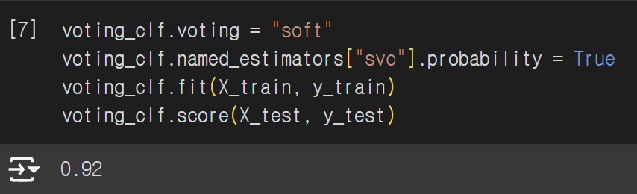
7.1 Voting Classifiers
Soft voting
: placing more weight on more likely votes
-> Higher performance than the hard voting

Slide 9
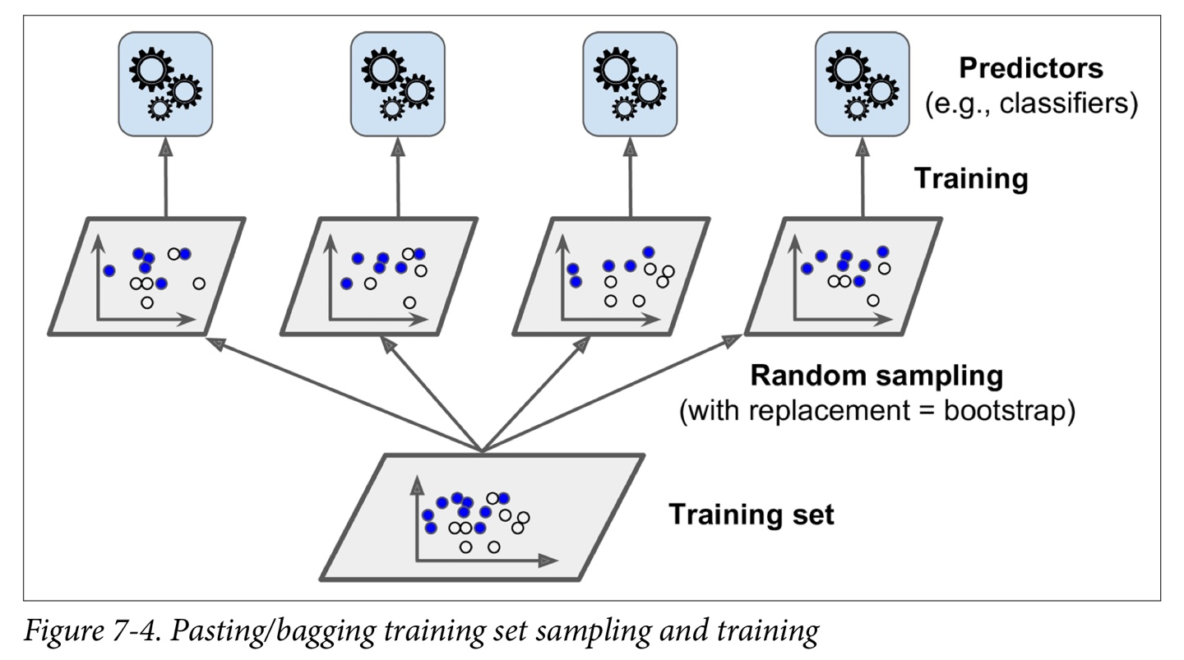
7.2 Bagging and Pasting
Bagging(bootstrap aggregating)
: Sampling by allowing redundancy in the training set
Pasting
: Sampling without allowing redundancy in the training set
<aggregation function>
Classifier -> statistical mode
Regression -> average

Slide 10
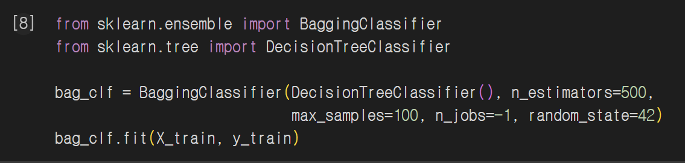
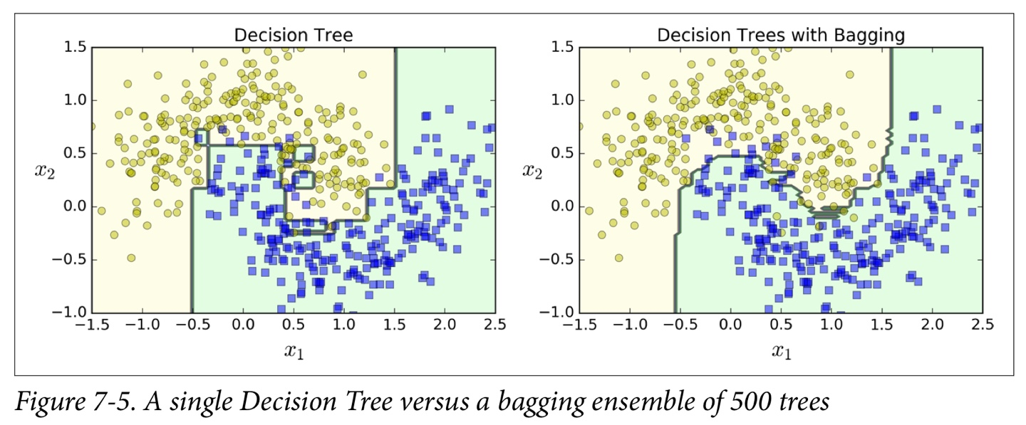
7.2 Bagging and Pasting

Slide 11
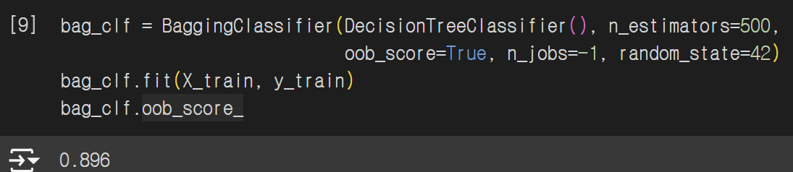
7.2 Bagging and Pasting
OOB(Out-of-Bag) Evaluation
: Use the remaining unused data for prediction

Slide 12
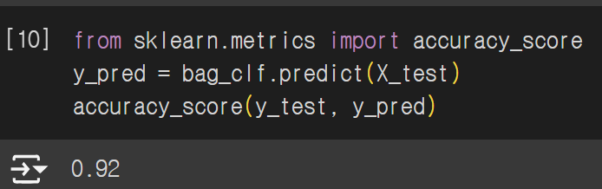
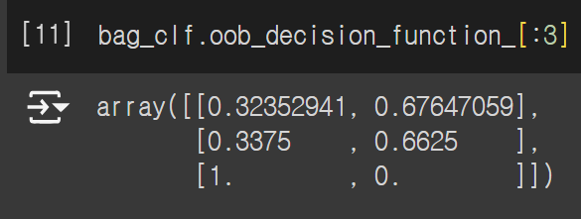
7.2 Bagging and Pasting

Slide 13
7.3 Random Patches and Random Subspaces
<Random patches method>
: Sampling both training instances and features
<Random subspaces method>
: Keeping all training instances but sampling features
(bootstrap=False, max_samples=1.0, bootstrap_features=True/max_features<1.0)

Slide 14
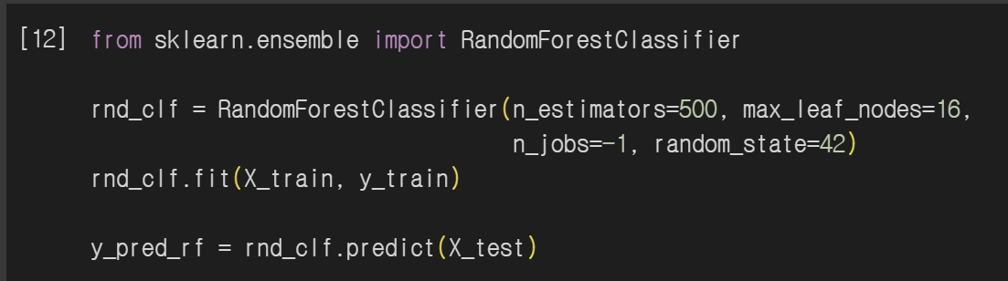
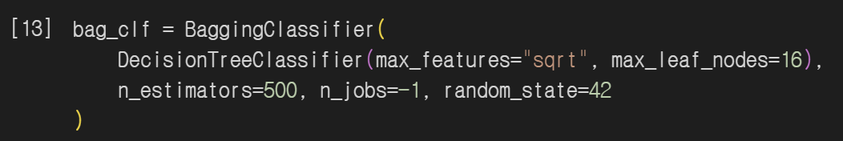
7.4 Random Forests

Slide 15
7.4 Random Forests
Extra-Tree(extremely randomized tree)
Splitter=“random”
More bias lower variance
Faster to train than regular Random Forests

Slide 16
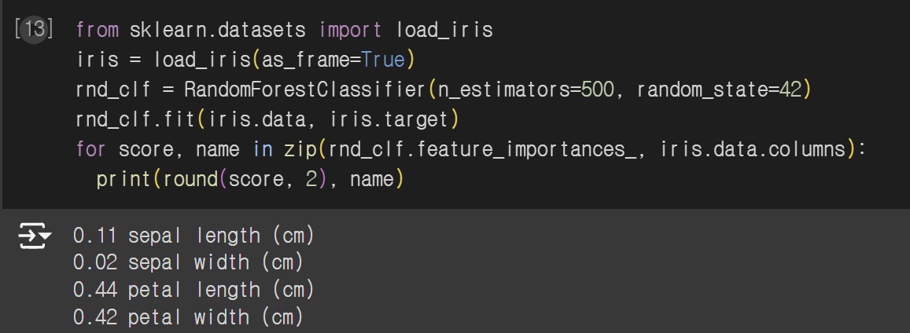


7.4 Random Forests
feature_importance_

Slide 17
7.5 Boosting
Boosting(hypothesis boosting)
: Esemble method that can combine several weak learners into a strong learner
(AdaBoost, Gradient Boosting)

Slide 18
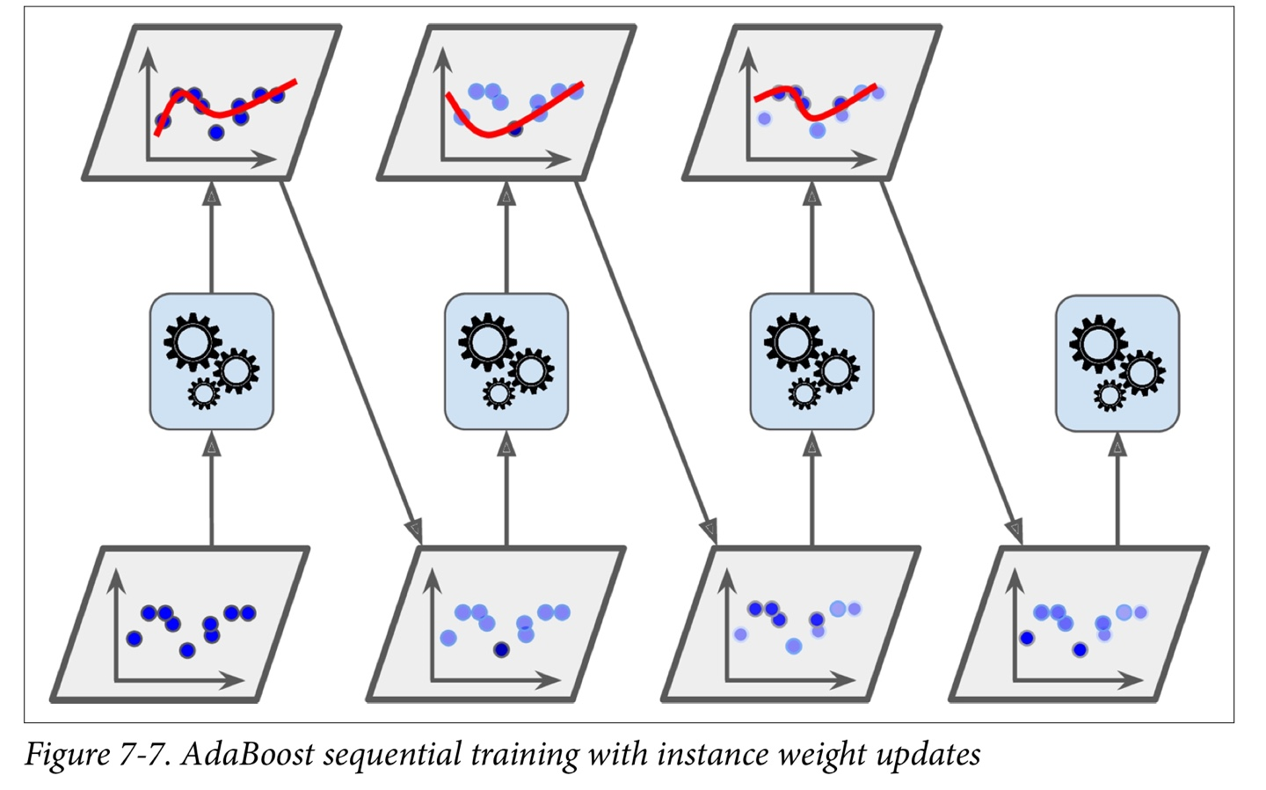
7.5 Boosting
Adaboost
More attention to the training instances that the predecessor underfitted

Slide 19
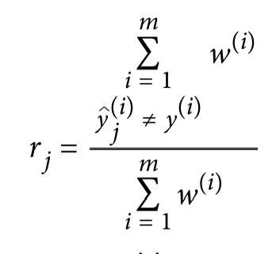
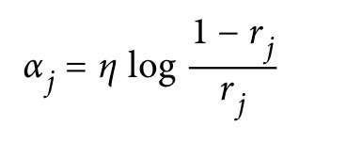
7.5 Boosting
Weighted error rate of the j-th predictor
Predictor weight

Slide 20
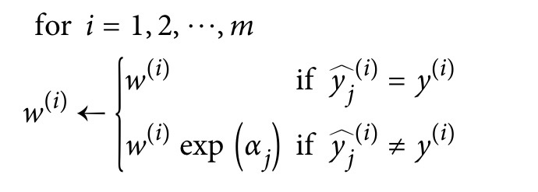
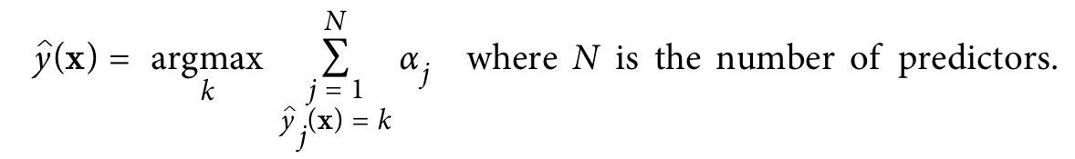
7.5 Boosting
Weight update rule
AdaBoost predictions

Slide 21
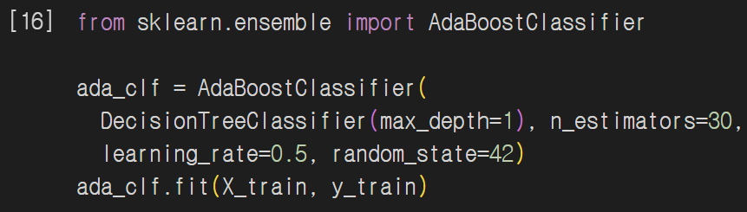
7.5 Boosting
The default base estimator for the AdaBoostClassifier class

Slide 22
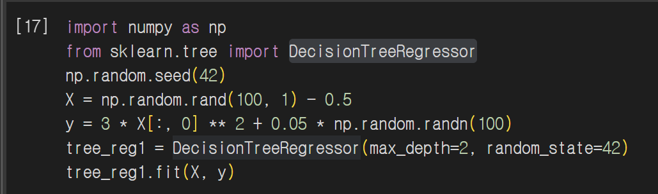
7.5 Boosting
Gradient Boosting
: fit the new predictor to the residual errors made by the previous predictor
Gradient tree boosting/gradient boosted regression tree(GBRT)

Slide 23
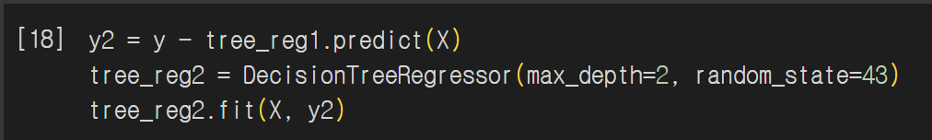
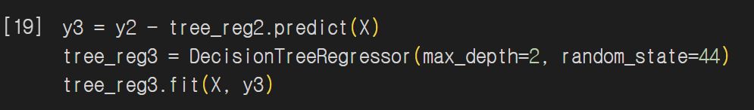
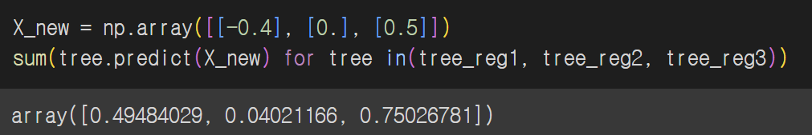
7.5 Boosting

Slide 24
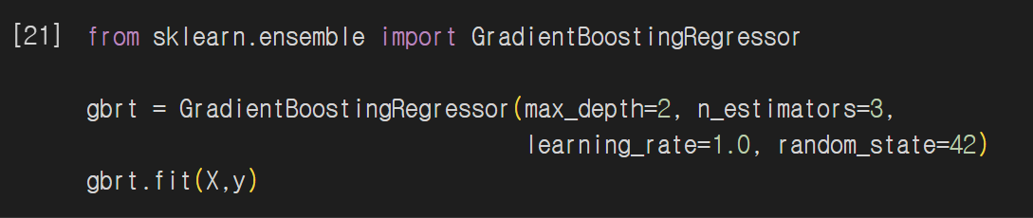
7.5 Boosting

Slide 25
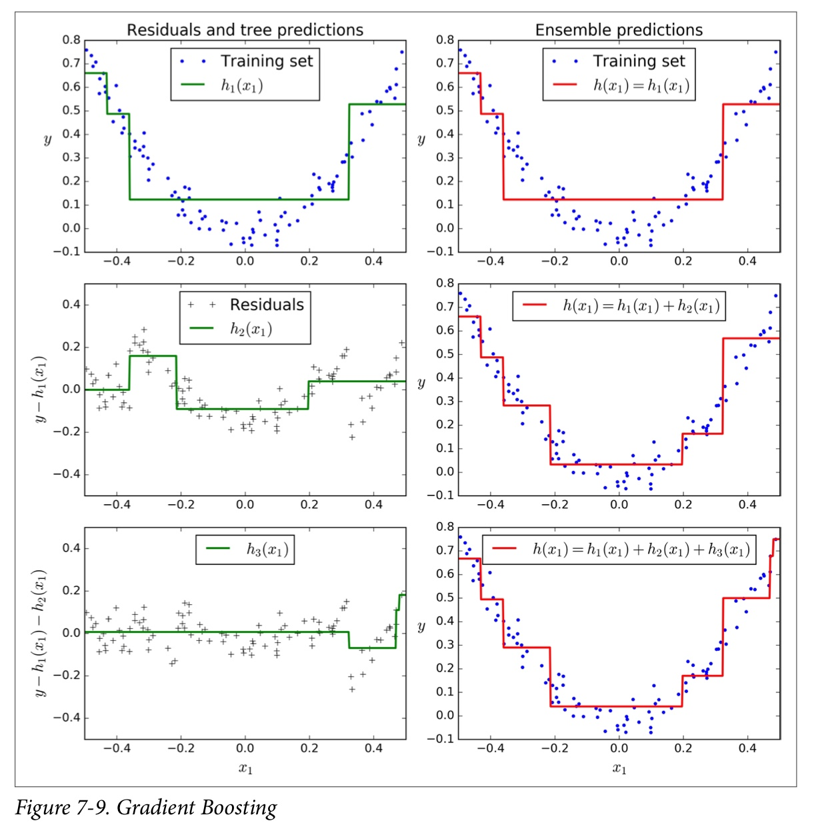
7.5 Boosting

Slide 26
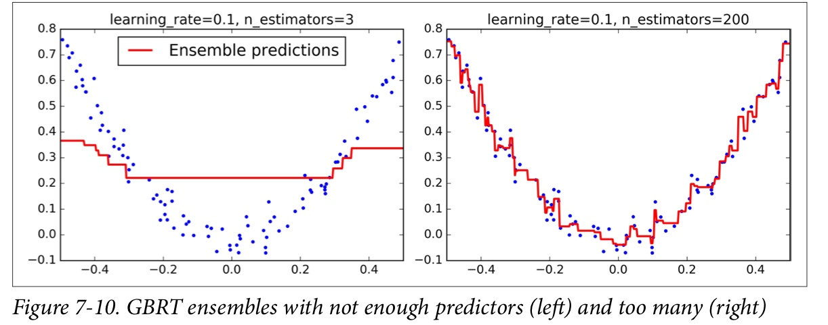
7.5 Boosting
learning_rate
: hyperparameter scales the contribution of each tree
Set low value -> need many trees -> predictions generalize better(shringkage)

Slide 27
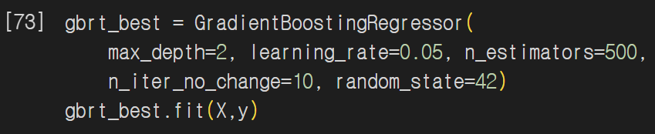
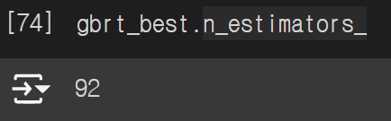
7.5 Boosting
n_iter_no_change = 10
: GradientBoostingRegressor automatically stops adding trees if the last 10 trees are unhelpful
Stochastic gradient boosting
: use subsample to specify the proportion of training samples

Slide 28
7.5 Boosting
Histogram-based gradient boosting(HGB)
: to divide the input characteristics into sections and replace them with integers
<Calculation complexity>
O(nxmxlog(m)) -> O(bxm)
b: number of sections
m: number of training sample
n: number of characteristic

Slide 29
7.6 Stacking
Instead of using trivial functions(such as hard voting) to aggregate the predictions of all predictors in an ensemble, why don’t we train a model to perform this aggregation?
Stacking(stacked generalization)
: Combining the predictions of multiple models to compensate for the shortcomings of a single model and increase overall performance

Slide 30
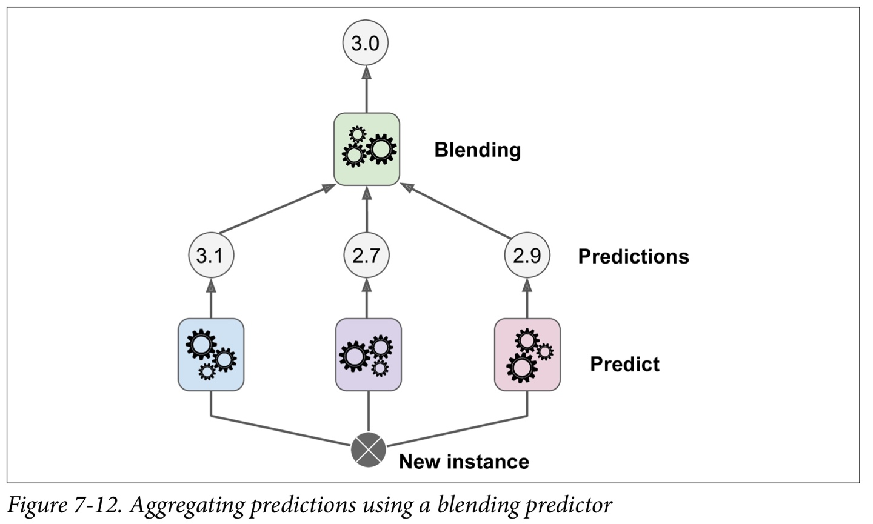
7.6 Stacking

Slide 31
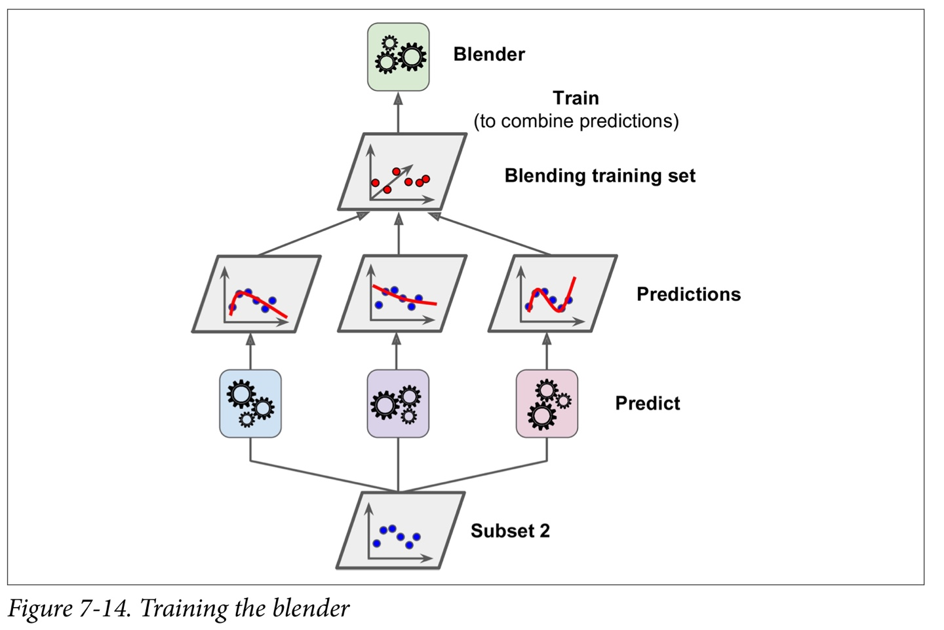
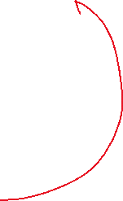
7.6 Stacking

Slide 32
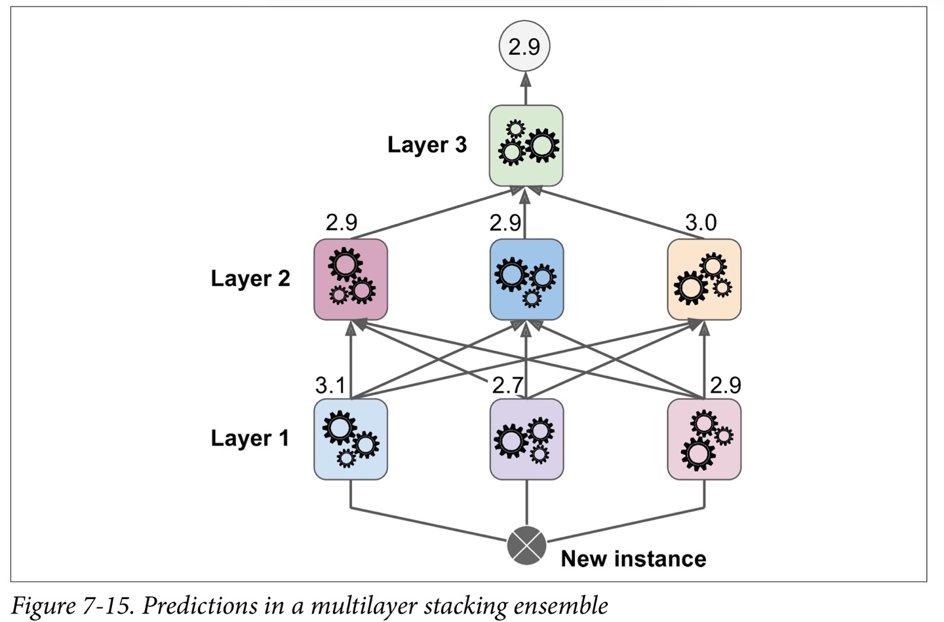
7.6 Stacking

Slide 33
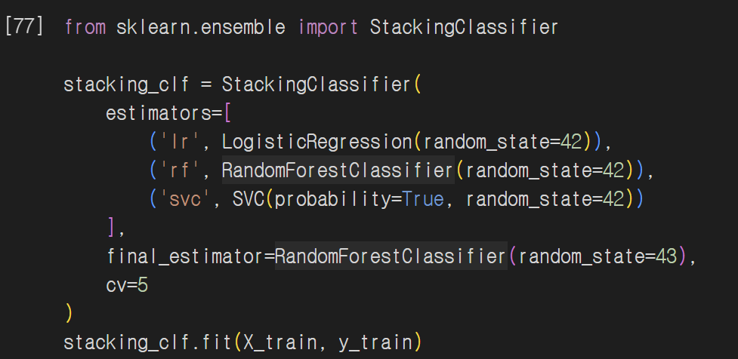
7.6 Stacking

Slide 34
Thank You For Listening

